Slide 1

YTP Controller – Part 1
Mar 2018

Slide 2
Goals
Success Criteria
Understand how buttons work as INPUTs
Understand how to create ground and 5 volt rails on a breadboard.
Introduce the Serial Monitor (it helps us understand what is happening in our code)
Create a single button circuit that reads input from a button

Slide 4
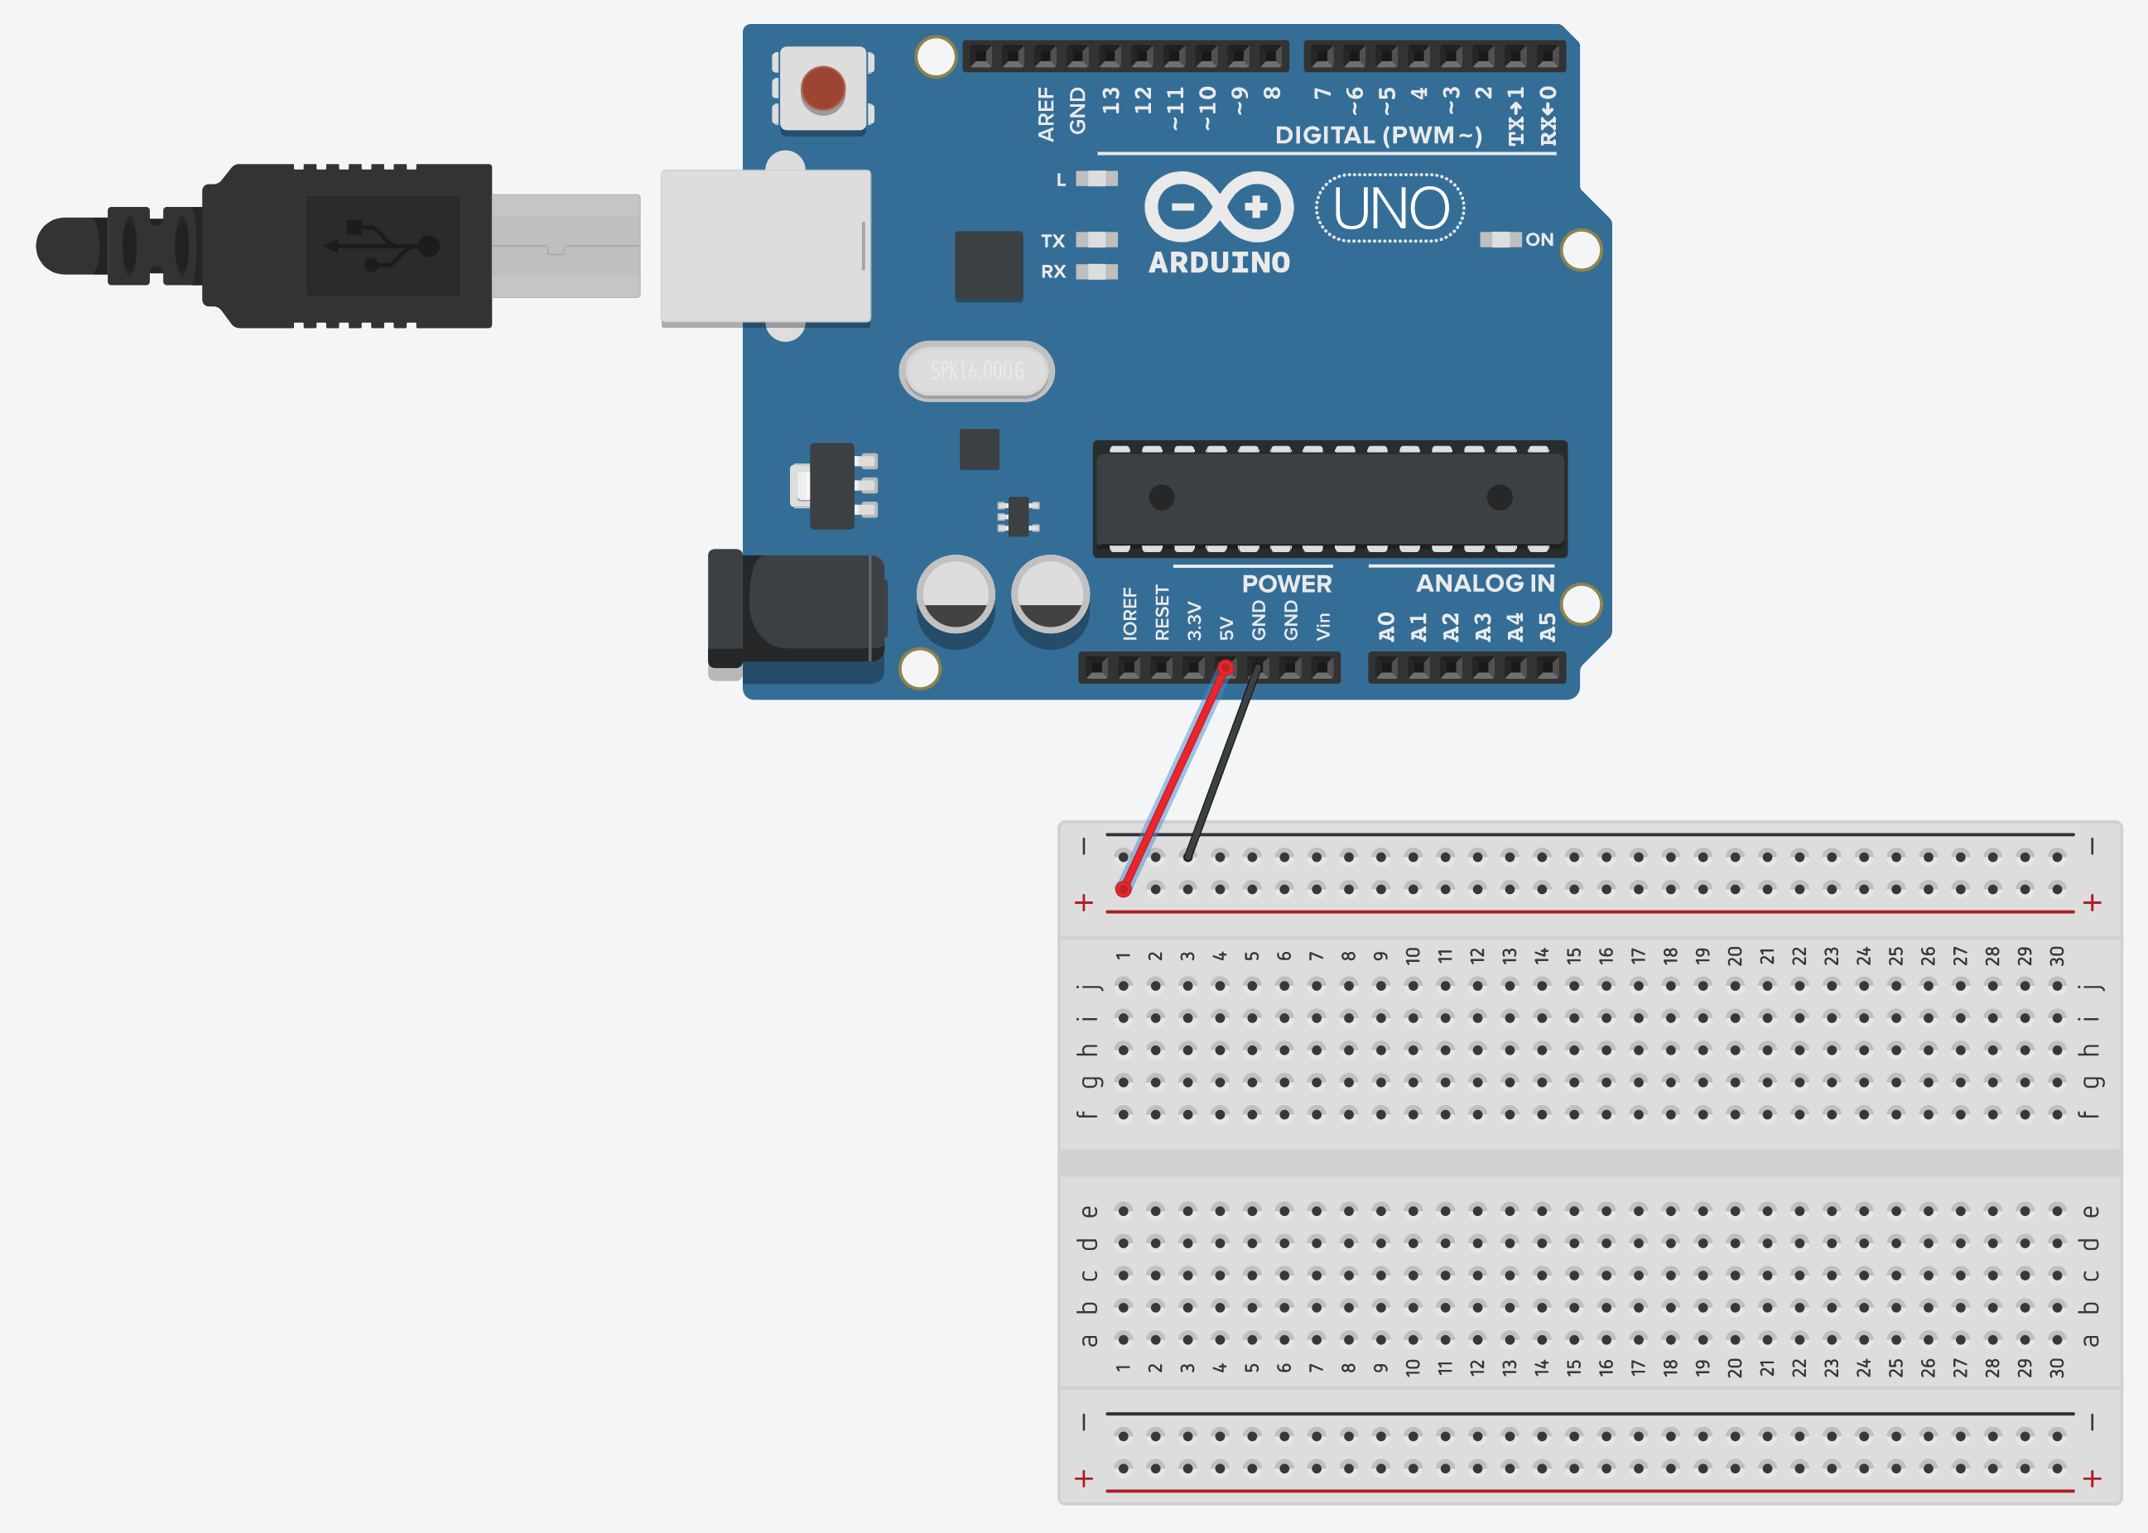

Slide 5


Slide 6
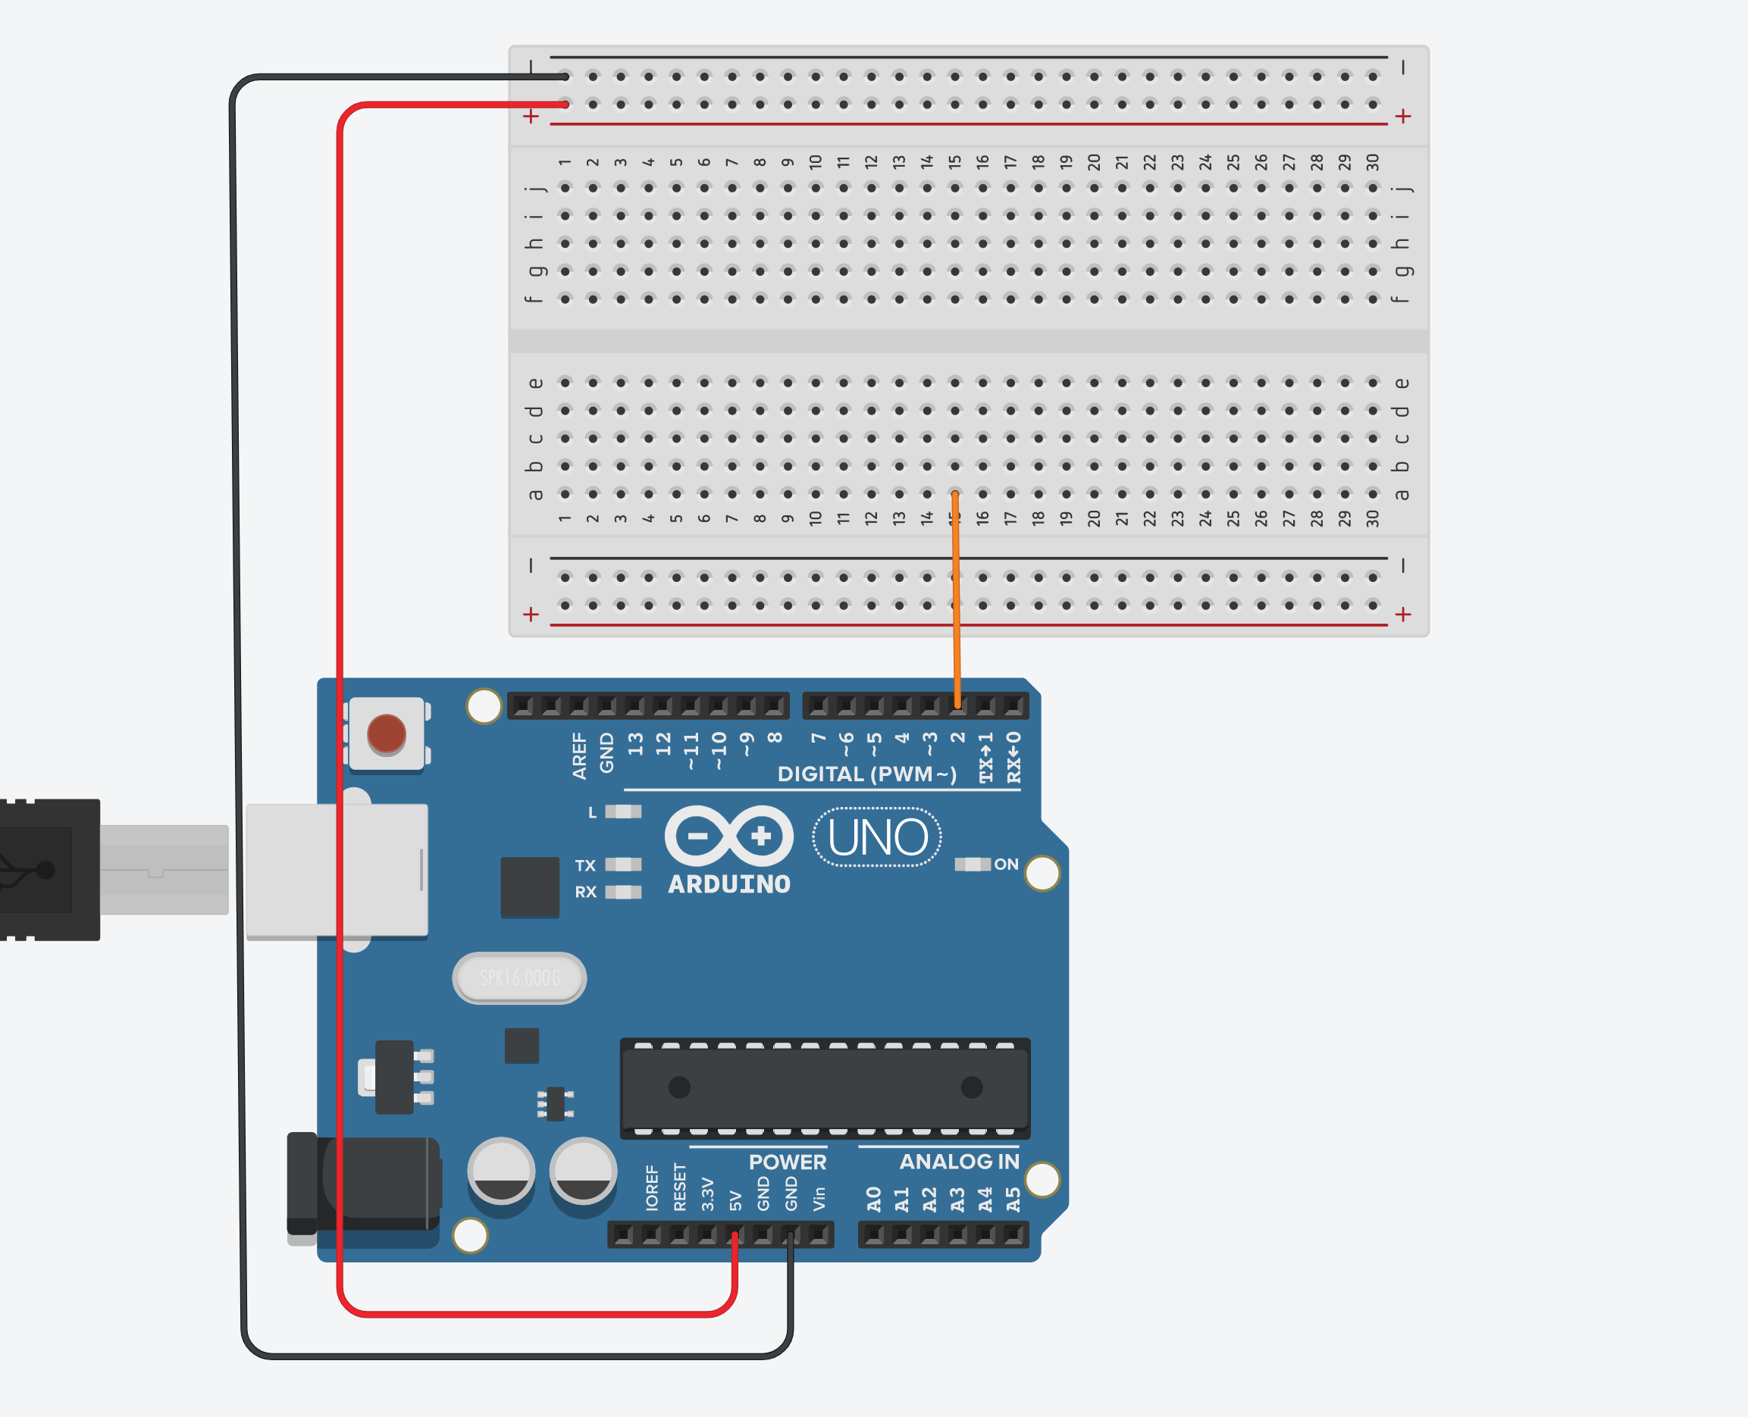
pinMode(2, INPUT)

Slide 7
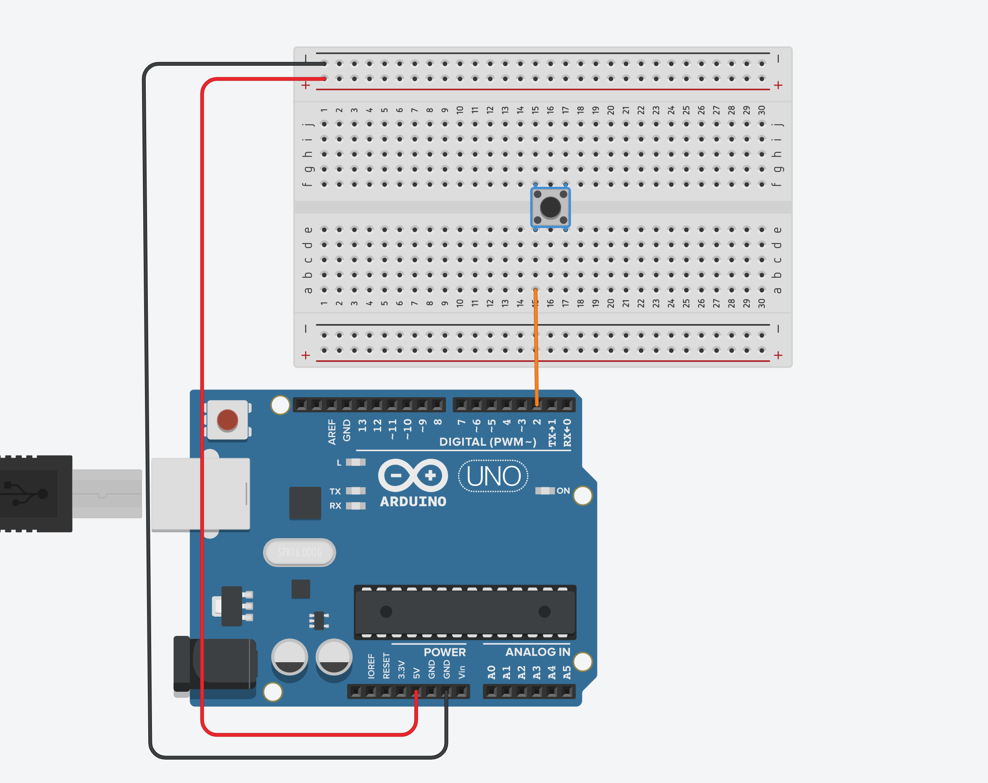
0 volts
5 volts

Slide 8
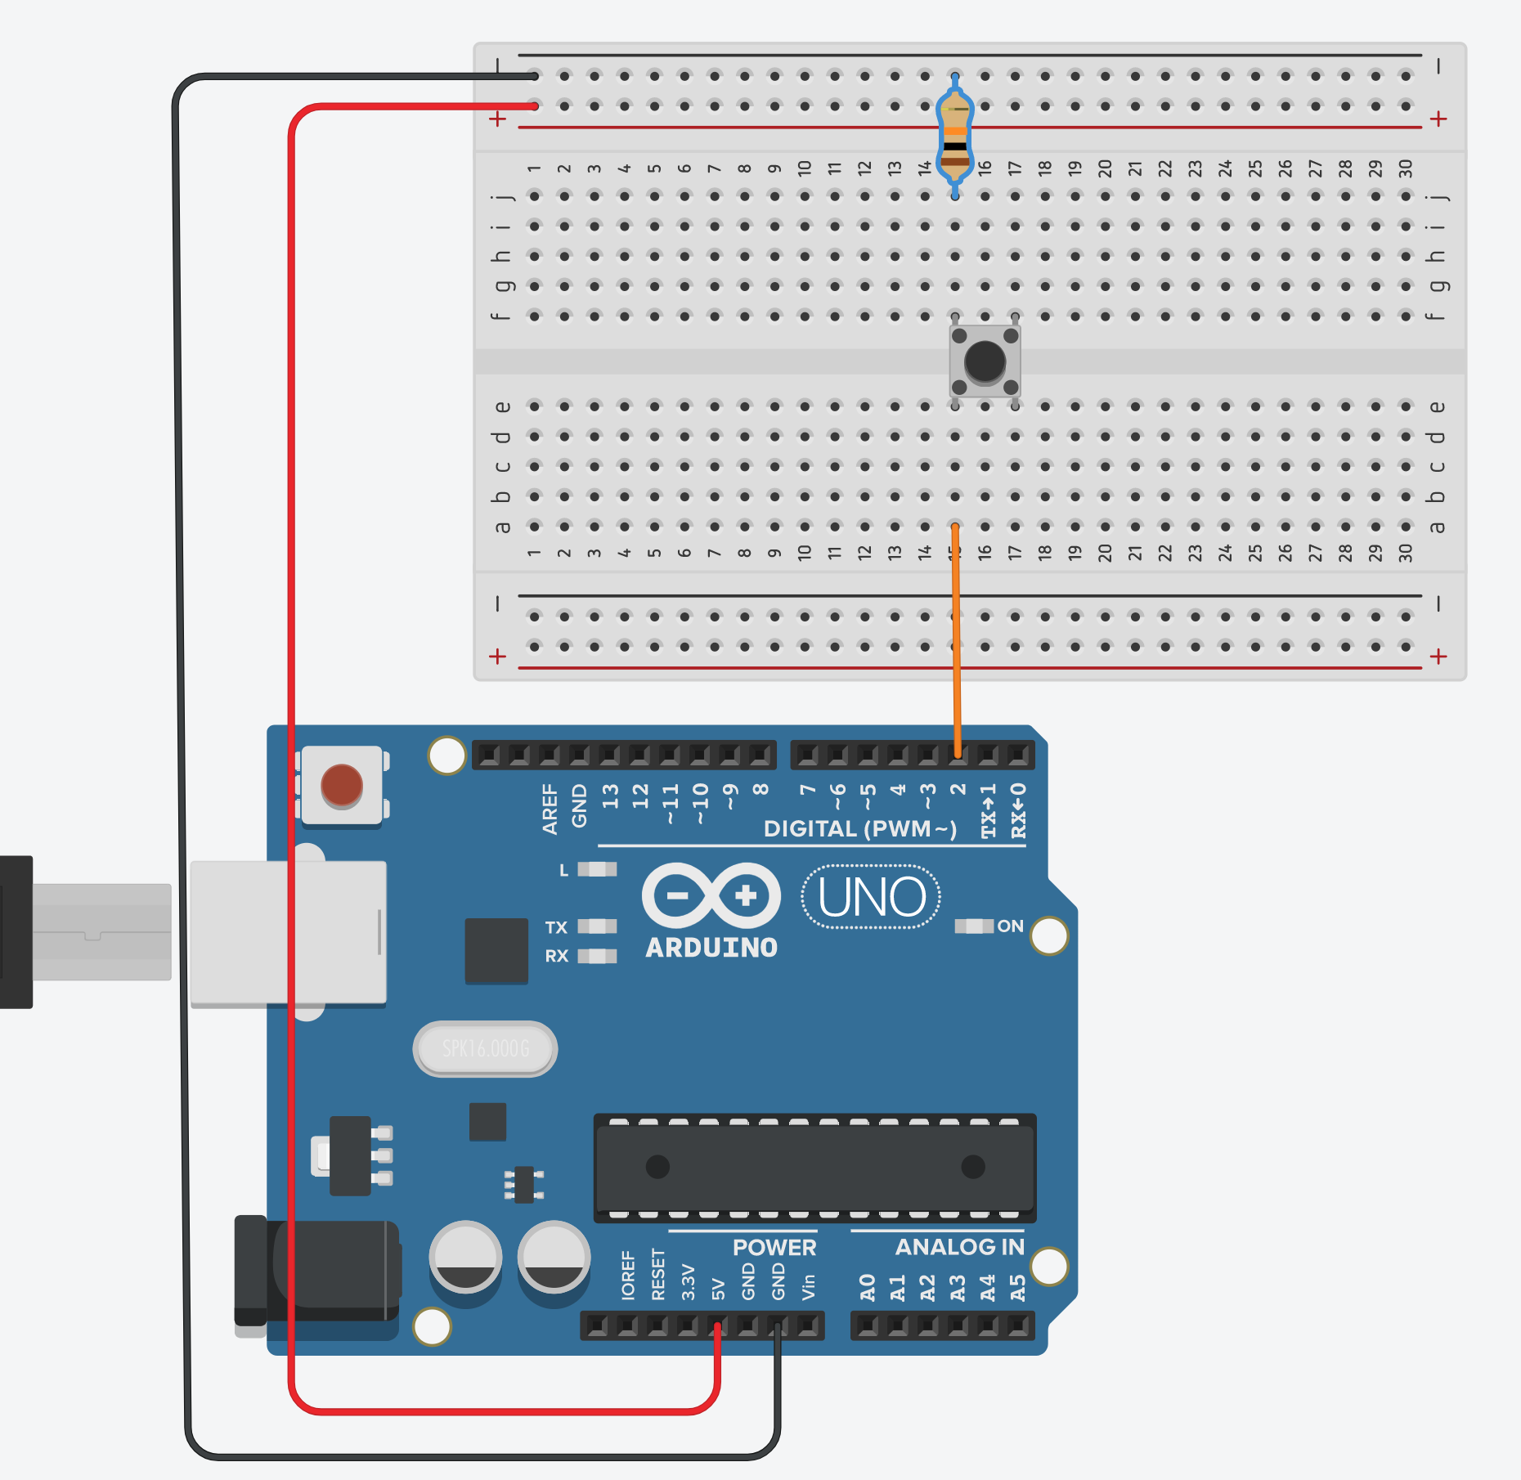
LOW
digitalRead(2) = ?

Slide 9
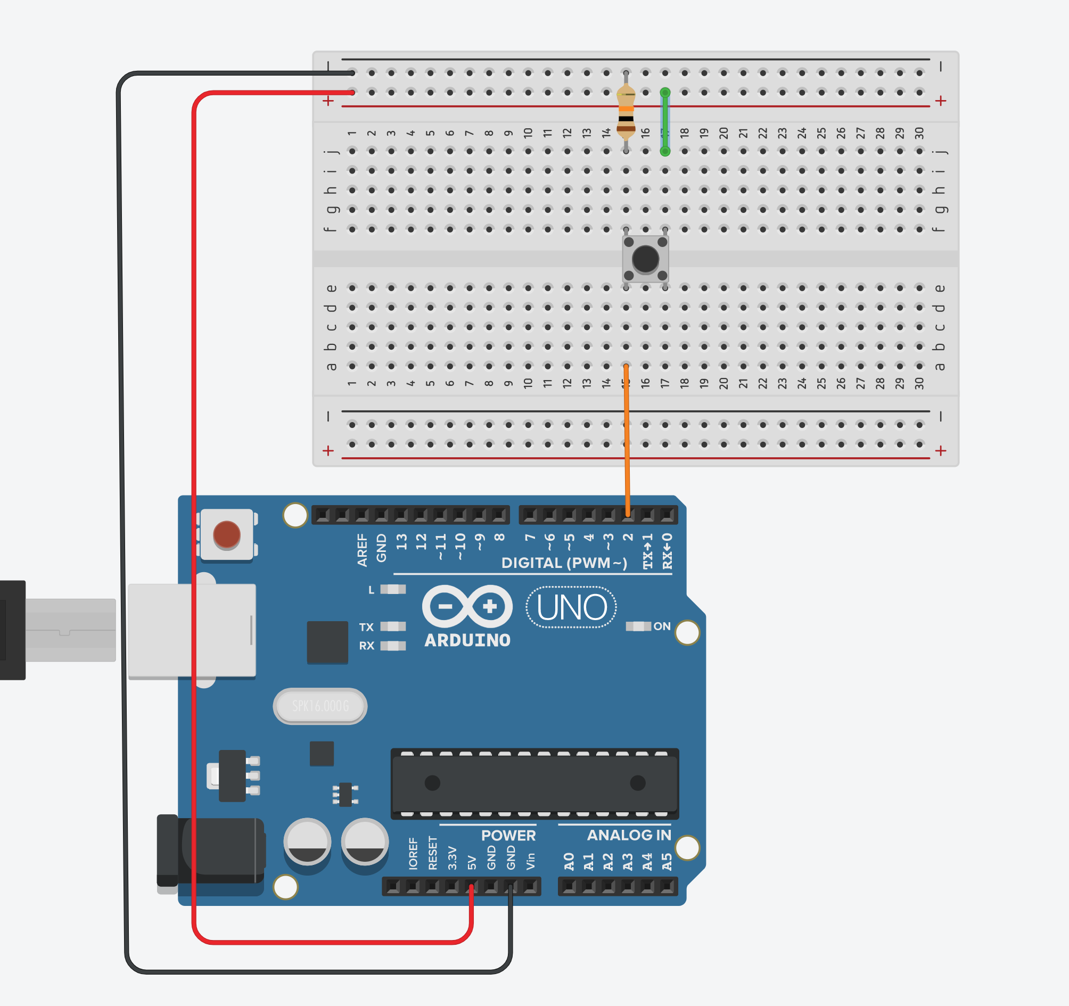
LOW
HIGH
digitalRead(2) = ?

Slide 10
Run the Code
Open the ‘button-test’ sketch
Upload the sketch to your Arduino
Open the Serial Monitor (Tools -> Serial Monitor)
Set the speed to 9600
Press the button – what happens in the Serial Monitor?
Why?

